Slide 1

Telematic Control Unit
Presented by Abhishek Tamboli

Slide 2
Introduction
Telematics is a term that combines the words telecommunications and informatics to describe the use of communications and IT to transmit, store and receive information from devices to remote objects over a network.
This technology plays a significant role in the automotive industry some of them are:
1. Data Collection
2. Communication
3. Remote Monitoring
4. Maintenance Alerts
5. Connected Services
6. Autonomous Vehicles
7. Data Analytics

Slide 3
Application of TCU
Fleet Management: Telematics enables real-time tracking of vehicles, optimizing routes, monitoring driver behaviour, and enhancing maintenance scheduling for businesses with vehicle fleets.
Remote Diagnostics: Telematics systems provide remote monitoring of vehicle health, allowing for proactive maintenance, reducing downtime, and minimizing repair costs.
Asset Tracking: Telematics is used to track and manage valuable assets, such as construction equipment, shipping containers, and trailers, ensuring their security and efficient utilization.
Connected Vehicles: Telematics is crucial for the development of connected cars, enabling features like remote start, over-the-air updates, and in-car entertainment.
Autonomous Vehicles: Telematics plays a vital role in autonomous vehicle development by providing real-time data for navigation and safety.

Slide 4
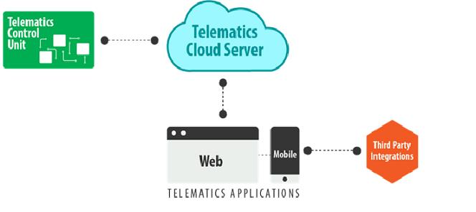
Components of TCU
A Vehicle telematics solution consists of the following 3 fundamental building blocks:
Telematics Control Unit
The Telematics Cloud Server
The Front End- Web app and Mobile App

Slide 5
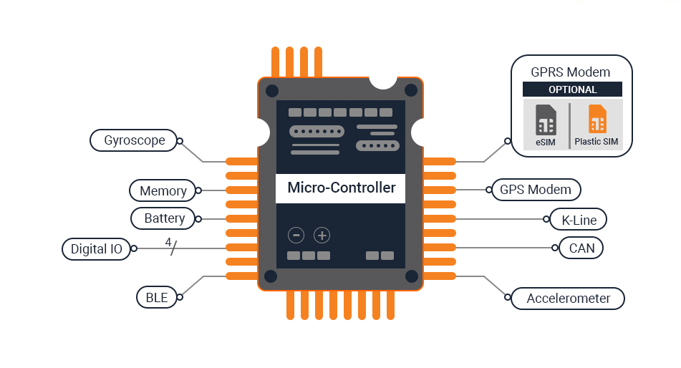
Telematic Control Unit
The Telematics Control Unit( TCU ) is the central component of a telematics system managing numerous functions such as:
Collecting vehicle data via CAN-BUS port
Managing information collected over various communication interfaces such as CAN, GPS, UART, GUI etc.
Memory and battery management
Managing two way communication with the Telematics Cloud Server
Managing the communication with the user dashboard/HMI device

Slide 6
TCU hardware components

Slide 7
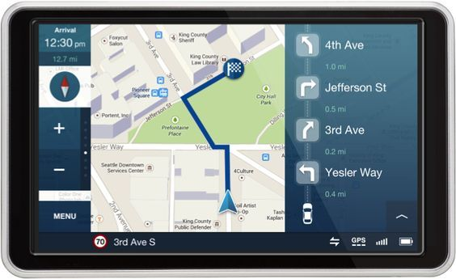
Global Positioning system
A Global Positioning System(GPS) module, for tracking the information associated with the latitude and longitude of the vehicle.

Slide 8
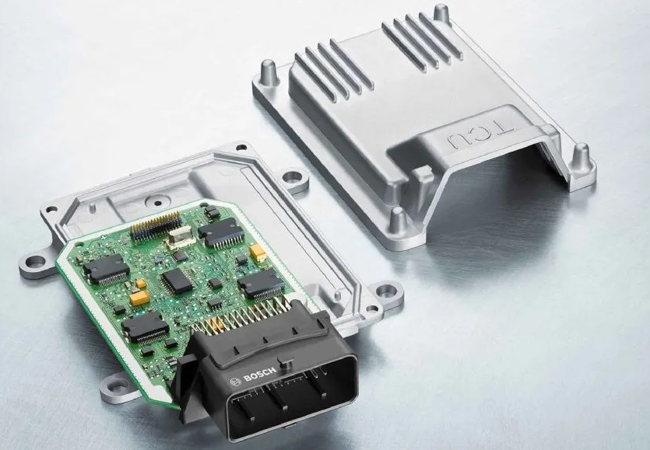
Central Processing Unit
A Central Processing Unit, with memory management and data processing capabilities.
Commercially available telematics systems are based on microcontrollers, microprocessors or even Field Programming Gate Array (FPGA) for managing multiple processes occurring within the TCU.

Slide 9
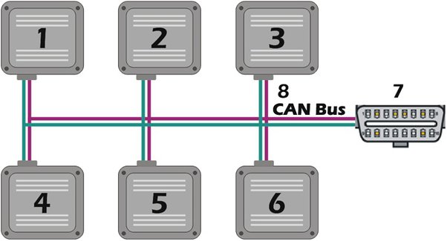
Can bus
CAN Bus module that manages all the communication with the vehicle ECUs. Many of the commercially available telematics devices also support OBD II, MOST, LIN interfaces.
The TCU communicates with the vehicle ECUs through CAN bus and fetches crucial information such as engine performance, vehicle speed, data from the Tire Pressure measuring Sensors, etc.
A telematics system may also use K/Line bus to alert the user about theft (by notifying the user if the vehicle is switched on by anyone), or to enable remote locking and unlocking of the vehicle.

Slide 10
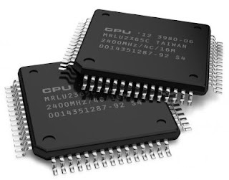
Memory unit
Memory unit, which is necessary for storing information during an unreliable or no network conditions; or in some cases, to store vehicle data for future use.
This memory module is also useful for supporting advanced telematics functionalities .

Slide 11
Other components
Communication interfaces to support a wide range of communication including Wi-Fi, cellular, LTE etc.
GPRS module: For data connectivity and in some cases voice based communication with remote devices. Often the GPRS module comes with a sim card, e-sim card or plastic sim cards, in addition to the GPRS modem to enable communication with remote devices over the cellular network.
Battery module: With voltage rating of 3.2 to 3.4 volts, for integrated power management. As a cost-effective backup source for Real-Time Clocks when the vehicle engine is off.
Bluetooth Module: To connect nearby devices with the telematics device, for interfacing with the end-user’s mobile phone for hands-free calls, text messages etc.

Slide 12
Other components
Microphone: Microphone with Audio interface to enable features such as hands-free calls, voice based commands. It also supports stereo based output to play media files from the vehicle audio system.
GPIO: A General Purpose Input/output interface (GPIO) system to connect lights, buttons. This includes both analog and digital I/O type interfaces.
HMI: The HMI/user interface device to showcase crucial information such as navigation maps, vehicle speed , fuel usage etc. The user can use the HMI to access features such as hands-free calls on the move, view map, playing media files etc. The HMI is connected to the TCU through a GUI or HDMI port.

Slide 13
TCU software components

Slide 14
An automotive telematics system comes with the following set of software components:
The Bootloader software stack for boot implementation
Real Time Operating System (RTOS) and BSP modules
Automotive Framework Classes that help the applications to access the primary telematics functionalities such as GPS data.
Global Navigation Satellite Systems (GNSS) software for real-time vehicle tracking and identification of the geo location.
Software for integration of data analytics to alert user about vehicle maintenance, fuel usage, vehicle usage patterns etc.
Software for Multimedia device drivers.
Device management software for Remote Over the air update of firmware ( FOTA) and software ( SOTA) images.
Security Algorithms for ensuring multi-level security of the telematics code and application through device and user authentication, data encryption, Content Filtering etc.

Slide 15
Telematic cloud server

Slide 16
Data Transmission from TCU to Cloud:
1. Data Collection: TCUs collect various data points from vehicles or assets, such as GPS location, vehicle speed, engine diagnostics, and driver behavior.
2. Data Transmission: TCUs use wireless communication, typically cellular networks, to transmit this data to the Telematics Cloud Server.
3. Secure Communication: Data transmission is usually encrypted to ensure the confidentiality and integrity of the data.

Slide 17
Data Encapsulation into MQTT Messages:
1. Data Packaging: The collected data is organized and packaged into messages. MQTT (Message Queuing Telemetry Transport) is a common protocol used for this purpose due to its lightweight and efficient publish-subscribe model.
2. Topic-based Communication: MQTT messages are often organized by topics, allowing the cloud server to subscribe to specific topics of interest.
3. Quality of Service (QoS): MQTT messages can be sent with varying levels of QoS, ensuring message delivery and reliability based on application requirements.

Slide 18
Storage and Processing in the Cloud:
1. Data Ingestion: The Telematics Cloud Server receives incoming MQTT messages and ingests the data into its storage and processing systems.
2. Data Processing: The server processes the incoming data, which may include real-time analysis for features like driver behavior monitoring, route optimization, and vehicle maintenance alerts.
3. Data Storage: Data is stored in databases that are optimized for efficient retrieval and analysis. It may be stored in relational databases.

Slide 19
Telematic front end access
The data stored in the telematics server can be accessed by the end user using either via a desktop or mobile application.
Based on the specific use case, the telematics data in the server can be fed into a third party software such as computerized mapping software, to apply further business logic on the available data.

Slide 20
Benefits of Telematics
Improved Fleet Management.
Enhanced Safety and Security.
Usage-Based Insurance.
Vehicle Maintenance Notifications.
Advanced Navigation and Traffic Information.
Ride-Sharing Convenience.

Slide 21
Thank you!!!

